Slide 1

LIBRARY
MANAGEMENT SYSTEM
DBMS CORNERSTONE PROJECT
25B11CS437 – K. Akshai Deepak
25B11CS724 – P. Thanoj
25B11CSA43 – Y. Sai Dinesh
25B11CS768 – P. Jaswanth Sai
9 August 2026
1

Slide 2
OUTLINE OF THE TALK
Introduction
Problem Statement
Objectives & End Users
Requirements
Entities & Attributes
Relationships & Cardinalities
ER Diagram,Schema diagram
System Workflow
Expected Benefits
Conclusion
Library Management System
2

Slide 3
THE PROBLEM
Manual library management makes it harder to maintain accurate records and find information quickly.
Book Tracking
Issue & Due Dates
Difficult to know which books are available, issued, or returned.
Manual entries can cause missed due dates and incorrect records.
Student Records
Fine Records
Finding and updating student borrowing information takes time.
Fine details may be missed when returns are handled manually.
Library Management System
3

Slide 4
OBJECTIVES
Aim: To develop a simple database system that organizes library information and makes daily library activities easier to manage.
01
Store Records
02
Manage Issues
03
Manage Returns
Maintain book, author, category, student and librarian details.
Record the student, book, librarian, issue date and due date.
Record return date and book condition.
04
Maintain Fines
05
Reduce Manual Work
06
Improve Accuracy
Store fine amount and payment status when required.
Make records easier to search, update and maintain.
Keep library information organized and consistent.
Library Management System
4

Slide 5
END USERS
Librarian
Student
Database Administrator / Project Team
Main user. Manages books, students, issue/return records and fines.
Uses the library to borrow and return books and check availability.
Maintains the database structure and ensures records remain organized.
Library Management System
5

Slide 6
REQUIREMENTS
Functional Requirements
Non-Functional Requirements
Add and manage book details
Manage author and category details
Manage student and librarian details
Record book issue and due date
Record returns and fines
Easy to use
Accurate and reliable
Quick information retrieval
Secure data
Easy to maintain
Library Management System
5

Slide 7
ENTITIES & ATTRIBUTES
AUTHOR
BOOK
Author_ID (PK)
Author_Name Country Email
Book_ID (PK)
Title ISBN Publication_Year Availability
Author_ID (FK) • Category_ID (FK)
CATEGORY
STUDENT
Category_ID (PK)
Category_Name Description
Student_ID (PK)
Student_Name Branch Year Phone Email
LIBRARIAN
ISSUE_BOOK
Issue_ID (PK)
Issue_Date Due_Date
Student_ID (FK) Book_ID (FK) Librarian_ID (FK)
Librarian_ID (PK)
Name Phone Email Shift
RETURN_BOOK
FINE
Return_ID (PK)
Return_Date Book_Condition Issue_ID (FK)
Fine_student_ID (PK)
Amount Payment_Status Return_ID (FK)
Library Management System
6

Slide 8
RELATIONSHIPS & CARDINALITIES
AUTHOR
→
WRITES
→
BOOK
1 : N
BOOK
→
BELONGS TO
→
CATEGORY
N : 1
STUDENT
→
BORROWS
→
ISSUE_BOOK
1 : N
ISSUE_BOOK
→
APPROVED BY
→
LIBRARIAN
N : 1
ISSUE_BOOK
→
RETURNED AS
→
RETURN_BOOK
1 : 1
RETURN_BOOK
→
GENERATES
→
FINE
1 : N
Library Management System
7

Slide 9
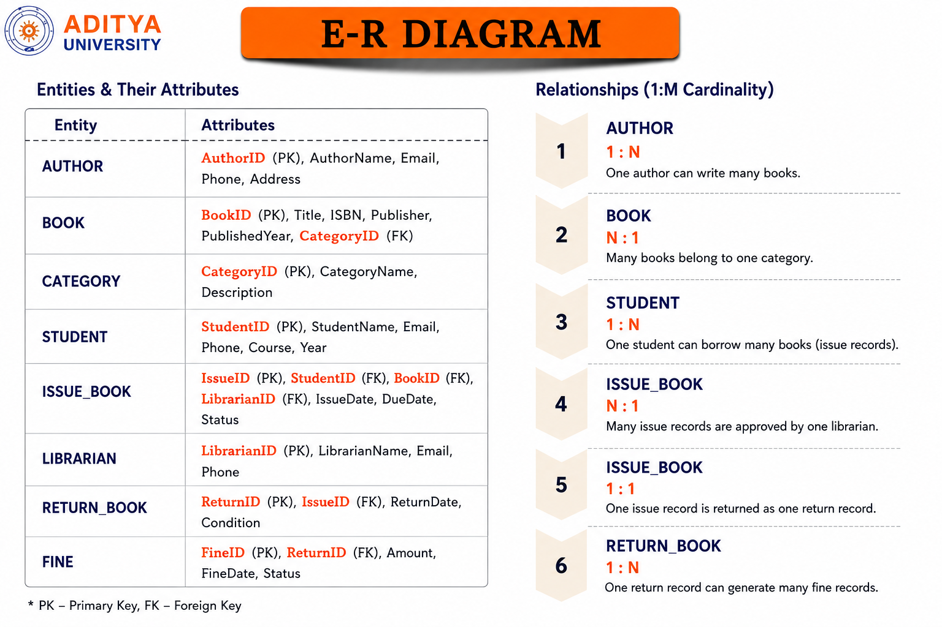

Slide 10
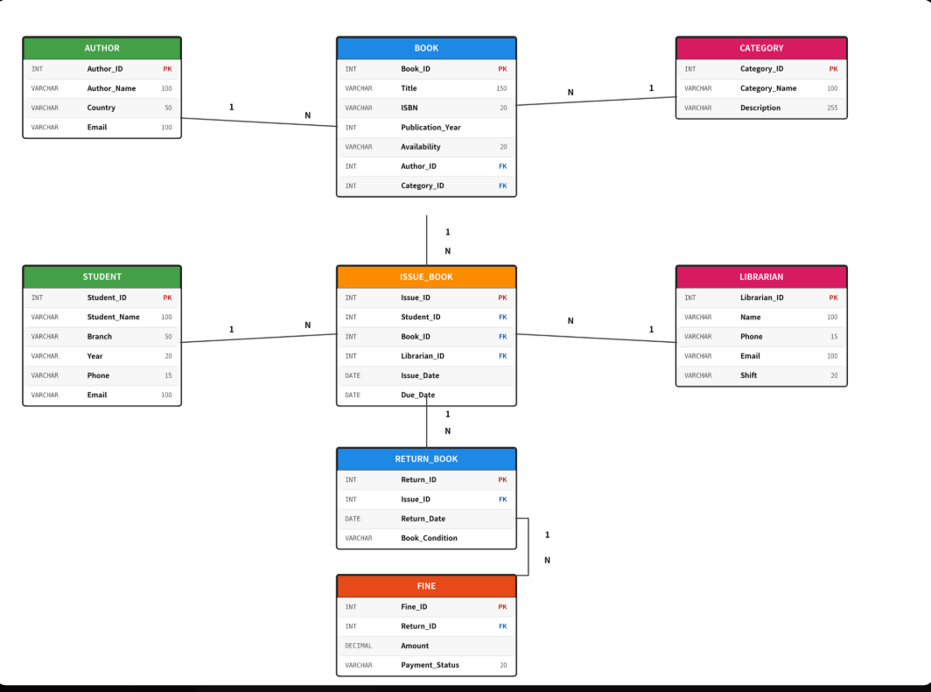
SCHEMA DIAGRAM
Library Management System
9

Slide 11
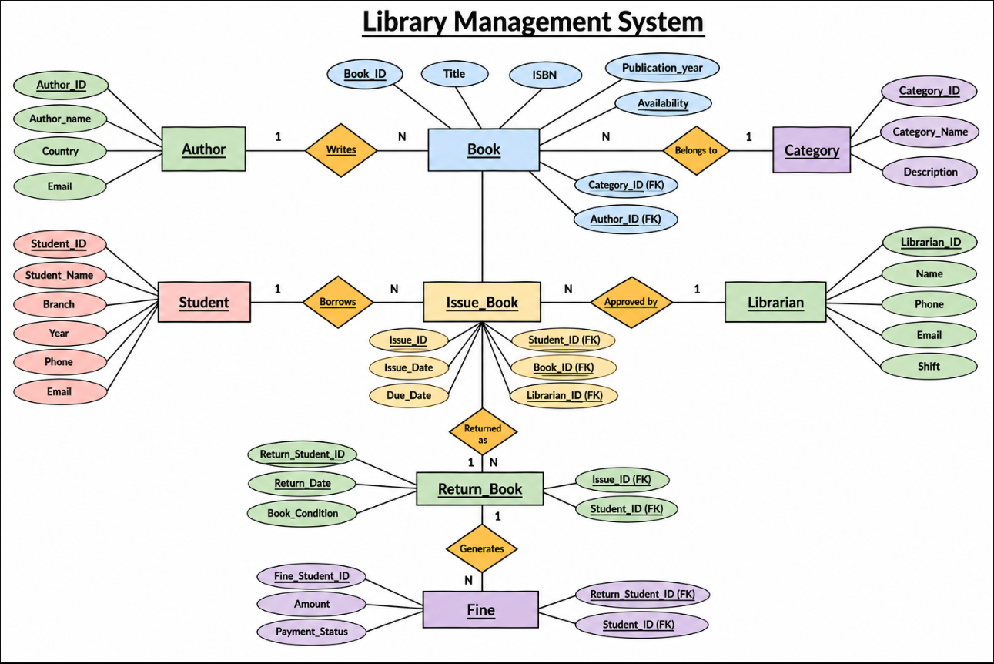
ER DIAGRAM
Library Management System
8

Slide 12
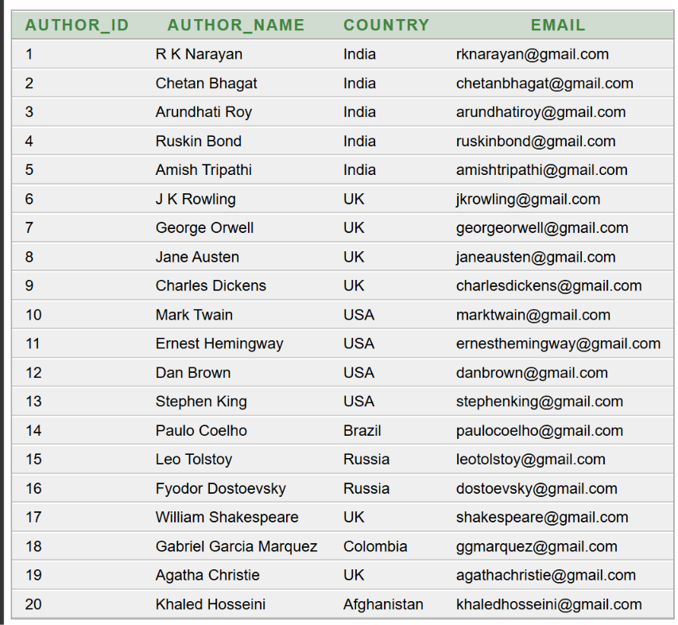
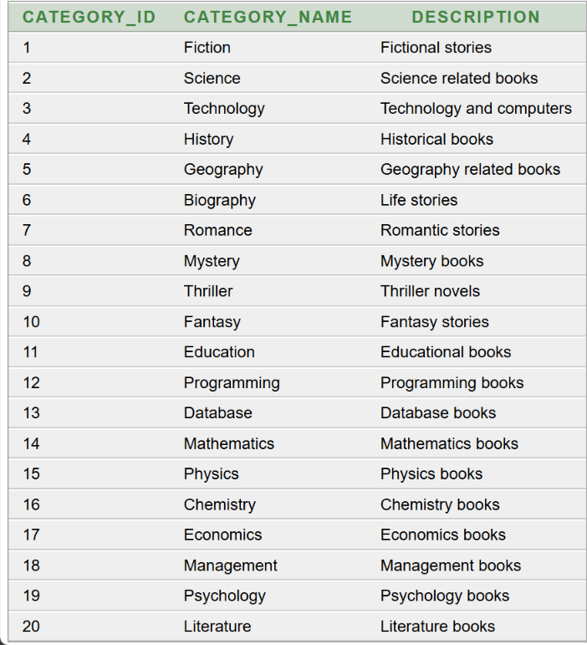
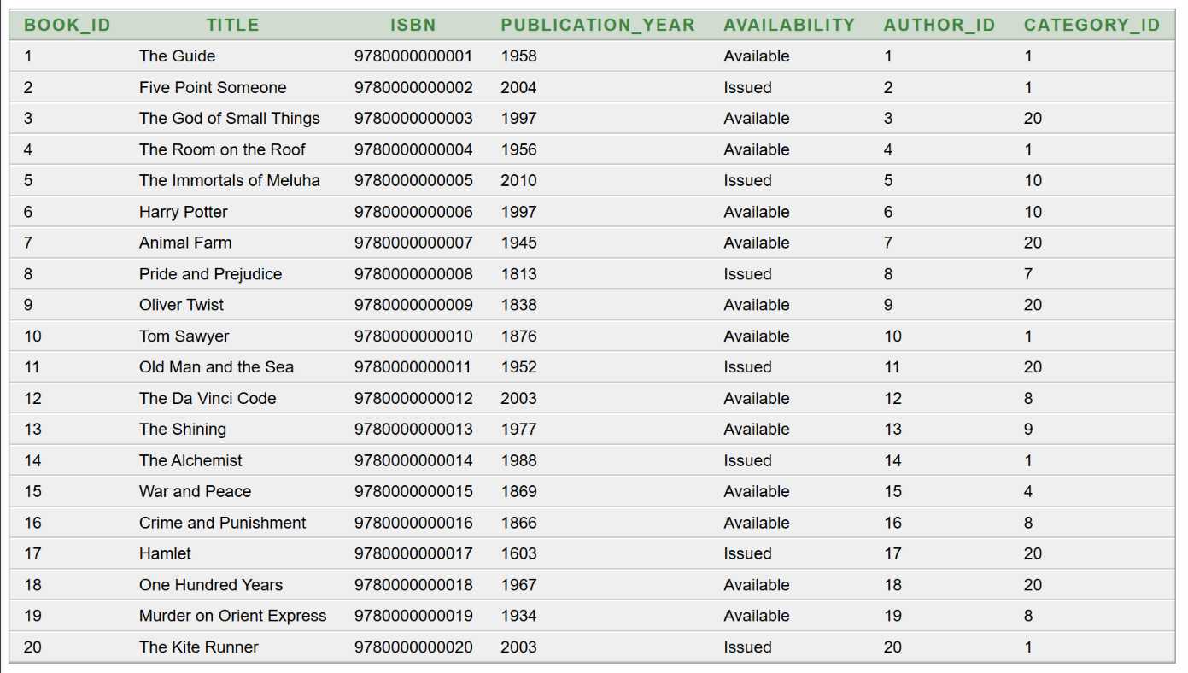
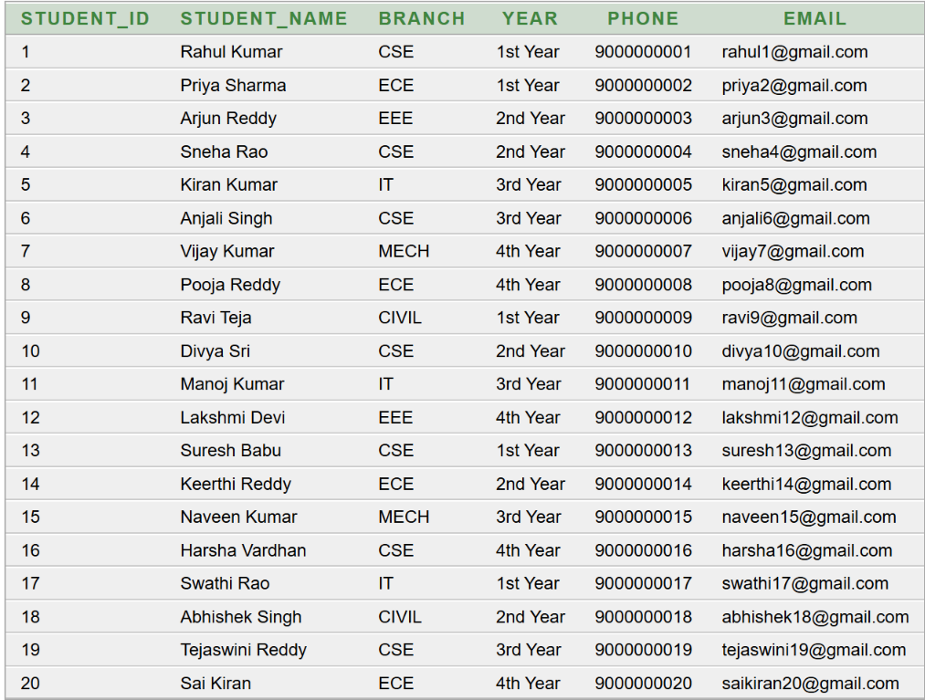
TABLE DATA — AUTHOR · CATEGORY · BOOK · STUDENT
AUTHOR
CATEGORY
BOOK
STUDENT
Library Management System
1

Slide 13
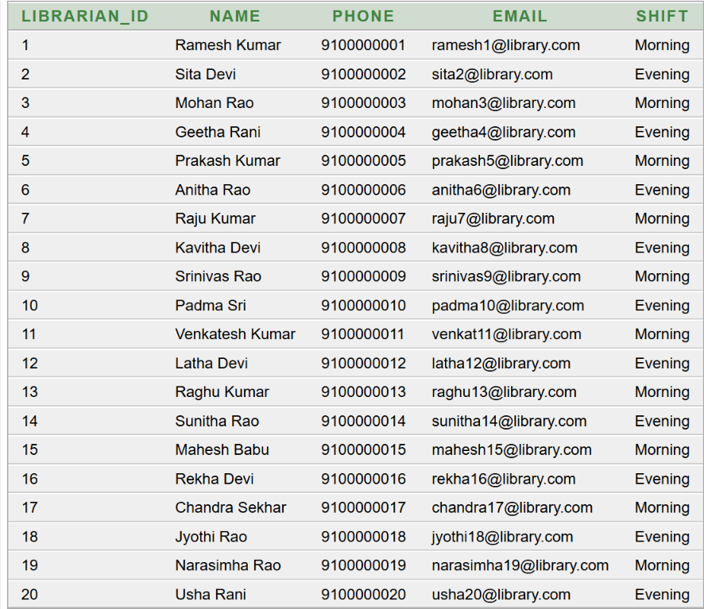
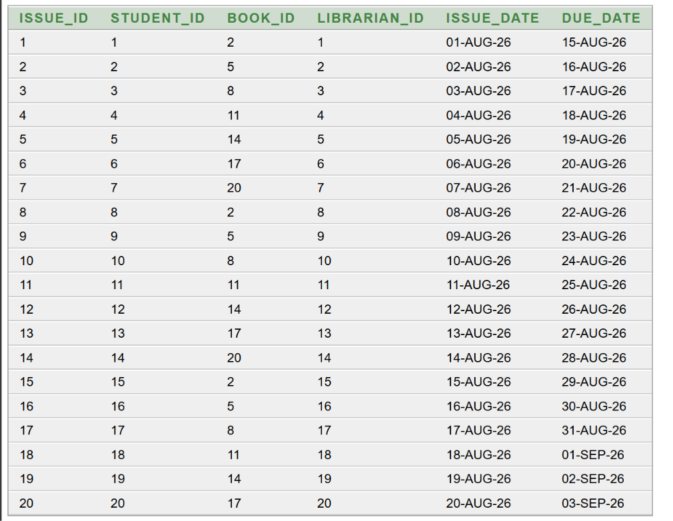
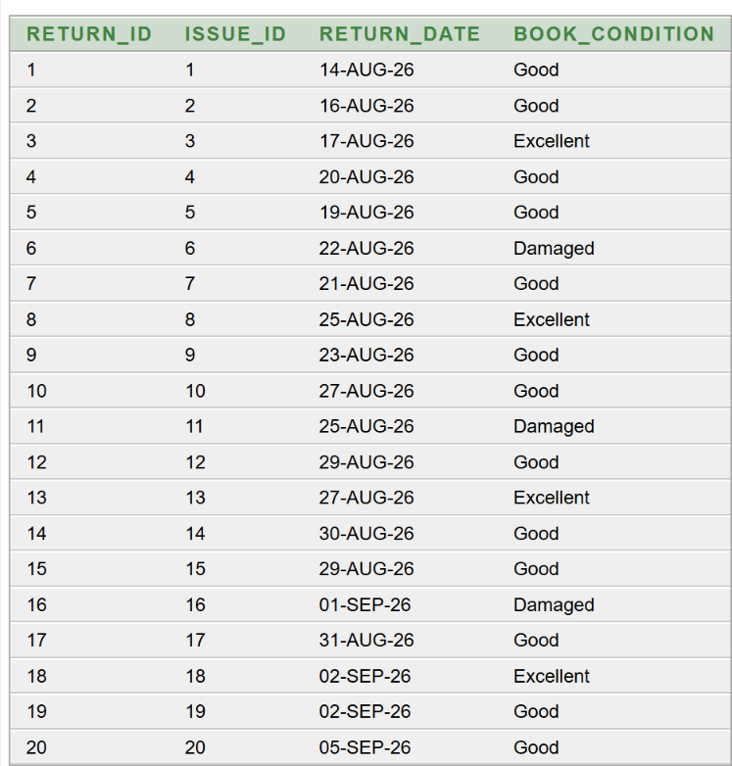
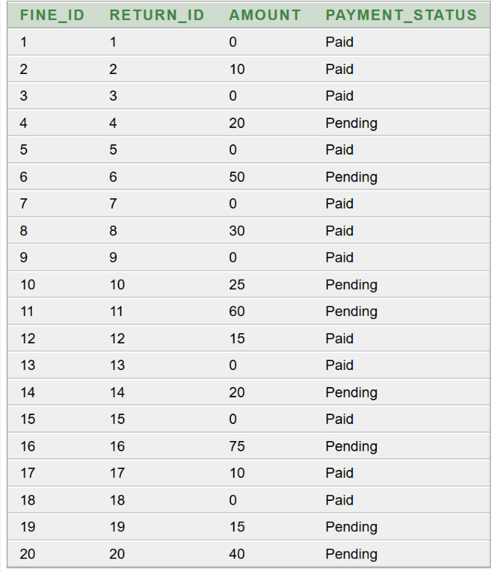
TABLE DATA — LIBRARIAN · ISSUE · RETURN · FINE
LIBRARIAN
ISSUE_BOOK
RETURN_BOOK
FINE
Library Management System
2

Slide 14
1–4. Author, Category, Student & Librarian → Book / Issue_Book
1. Author 1 — Writes — N Book | 2. Book N — Belongs to — 1 Category
3. Student 1 — Borrows — N Issue_Book | 4. Issue_Book N — Approved by — 1 Librarian
-- Author Table
CREATE TABLE Author (
Author_ID INT PRIMARY KEY,
Author_Name VARCHAR(100)
);
-- Category Table
CREATE TABLE Category (
Category_ID INT PRIMARY KEY,
Category_Name VARCHAR(100)
);
-- Book Table (FK → Author, Category)
CREATE TABLE Book (
Book_ID INT PRIMARY KEY,
Title VARCHAR(200),
Availability VARCHAR(20),
Author_ID INT, -- FK → Author
Category_ID INT, -- FK → Category
FOREIGN KEY (Author_ID)
REFERENCES Author(Author_ID),
FOREIGN KEY (Category_ID)
REFERENCES Category(Category_ID)
);
-- Student Table
CREATE TABLE Student (
Student_ID INT PRIMARY KEY,
Student_Name VARCHAR(100),
Department VARCHAR(50),
Contact VARCHAR(15)
);
-- Librarian Table
CREATE TABLE Librarian (
Librarian_ID INT PRIMARY KEY,
Librarian_Name VARCHAR(100),
Contact VARCHAR(15)
);
-- Issue_Book Table (FK → Student, Book, Librarian)
CREATE TABLE Issue_Book (
Issue_ID INT PRIMARY KEY,
Issue_Date DATE,
Due_Date DATE,
Student_ID INT, -- FK → Student
Book_ID INT, -- FK → Book
Librarian_ID INT, -- FK → Librarian
FOREIGN KEY (Student_ID)
REFERENCES Student(Student_ID),
FOREIGN KEY (Book_ID)
REFERENCES Book(Book_ID),
FOREIGN KEY (Librarian_ID)
REFERENCES Librarian(Librarian_ID)
);
DBMS | Library Management System — Foreign Key Relations
K Vydehi, Asst. Professor, CSE Dept.
1

Slide 15
5–6. Issue_Book → Return_Book → Fine & Relationship Summary
5. Issue_Book 1 — Returned as — N Return_Book | 6. Return_Book 1 — Generates — N Fine
Relationship Summary (Cardinality)
-- Return_Book Table
CREATE TABLE Return_Book (
Return_ID INT PRIMARY KEY,
Return_Date DATE,
Issue_ID INT, -- FK → Issue_Book
FOREIGN KEY (Issue_ID)
REFERENCES Issue_Book(Issue_ID)
);
-- Fine Table
CREATE TABLE Fine (
Fine_ID INT PRIMARY KEY,
Fine_Amount DECIMAL(10,2),
Fine_Date DATE,
Return_ID INT, -- FK → Return_Book
FOREIGN KEY (Return_ID)
REFERENCES Return_Book(Return_ID)
);
Relationship | Card. | Foreign Key
Author → Book | 1 : N | Book.Author_ID
Category → Book | 1 : N | Book.Category_ID
Student → Issue_Book | 1 : N | Issue_Book.Student_ID
Librarian → Issue_Book | 1 : N | Issue_Book.Librarian_ID
Issue_Book → Return_Book | 1 : N | Return_Book.Issue_ID
Return_Book → Fine | 1 : N | Fine.Return_ID
Create parent tables first (Author, Category, Student, Librarian), then Book → Issue_Book → Return_Book → Fine. All six FKs implement the ER diagram relationships.
DBMS | Library Management System — Foreign Key Relations
K Vydehi, Asst. Professor, CSE Dept.
2

Slide 16
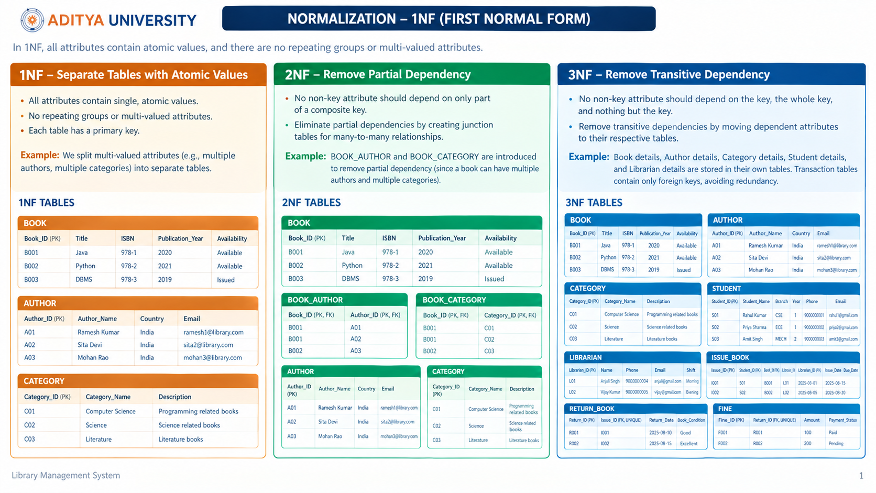
NORMALIZATION: UNNORMALIZED → 1NF → 2NF
Goal: Remove repeating groups and partial dependencies using the Library schema.
PROBLEM — Unnormalized / Weak 1NF
SOLUTION — Reach 2NF
If everything lived in one flat table:
Split into tables so every non-key attribute depends on the whole PK:
Issue_ID | Student_Name | Branch | Book_Title | Author_Name | Category | Librarian | Fine_Amt
AUTHOR8
Author_ID (PK), Author_Name, Country, Email
1 | Rahul Kumar | CSE | Five Point Someone | Chetan Bhagat | Fiction | Ramesh | 0
2 | Priya Sharma | ECE | Immortals of Meluha | Amish | Fantasy | Sita | 10
… Author & Category repeated for every issue
CATEGORY8
Category_ID (PK), Category_Name, Description
Repeating groups
BOOK8
Book_ID (PK), Title, ISBN, Year, Availability
+ FK → Author_ID, Category_ID
Author, Category, Student details copy-pasted on every issue row
Partial dependency
STUDENT8
Student_ID (PK), Name, Branch, Year, Phone, Email
Book Title depends only on Book_ID, not on full composite key
Update anomaly
LIBRARIAN8
Librarian_ID (PK), Name, Phone, Email, Shift
Change author country → must edit many rows; risk of inconsistency
Insertion anomaly
ISSUE_BOOK8
Issue_ID (PK), Issue_Date, Due_Date
+ FK → Student, Book, Librarian
Cannot store a new author until a book is issued
Library Management System
1

Slide 17
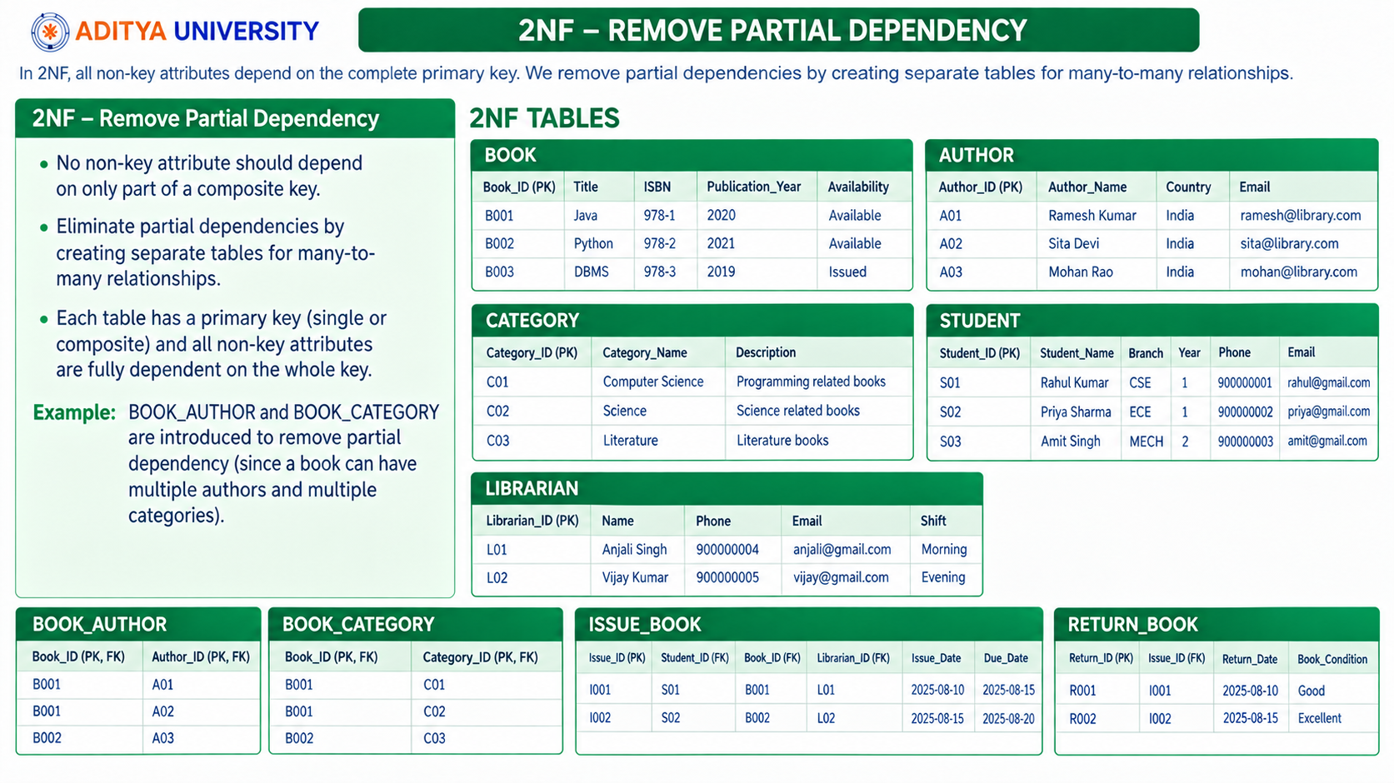
NORMALIZATION: 2NF → 3NF (FINAL SCHEMA)
Remove transitive dependencies so non-key attributes depend only on the Primary Key.
TRANSITIVE DEPENDENCY
HOW WE ACHIEVED 3NF
FINAL 3NF TABLES
If we had kept fine details inside ISSUE:
1
RETURN_BOOK8
AUTHOR8
LIBRARIAN8
Issue_ID → Return_Date → Amount
Issue_ID → Student_ID → Branch
Return_Date & Book_Condition depend only on Return_ID / Issue_ID (1:1)
2
FINE8
CATEGORY8
ISSUE_BOOK8
Amount & Payment_Status depend only on Return_ID — not on Student or Book
Amount depends on Return, not directly on Issue_ID.
Branch depends on Student, not on Issue_ID.
3
No Title in ISSUE
BOOK8
RETURN_BOOK8
Book Title lives only in BOOK8; ISSUE stores Book_ID (FK)
Result: update / insert anomalies again.
No Branch in ISSUE
STUDENT8
FINE8
4
3NF rule: non-key attr must depend only on the PK (no A→B→C).
Student Branch lives only in STUDENT8; ISSUE stores Student_ID
WHY THIS DESIGN IS IN 3NF
1NF
2NF
3NF
Benefit
Atomic columns only (no multi-valued fields)
No partial dependency — Book attrs depend on Book_ID alone
No transitive dependency — Fine depends on Return_ID only
No redundancy · easy updates · consistent data · scalable
Library Management System
2

Slide 18
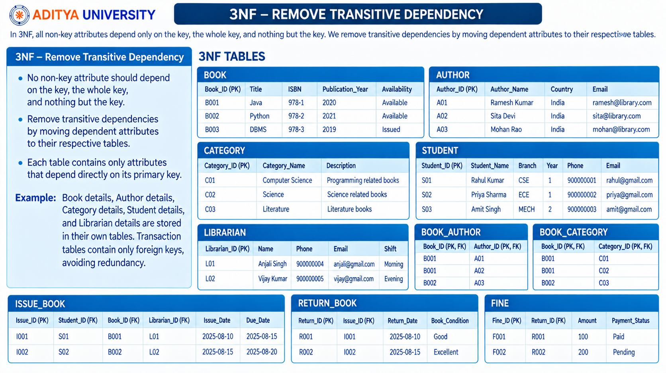

Slide 19
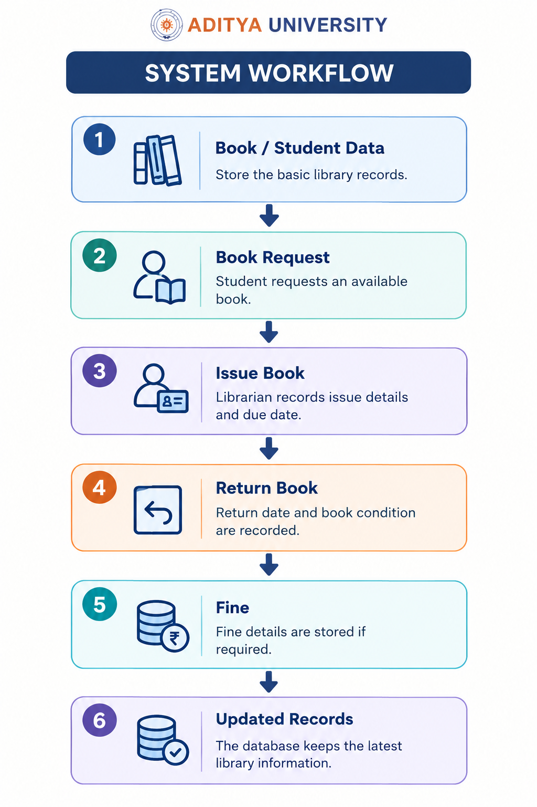

Slide 20
CONCLUSION
The Library Management System provides a simple and organized way to manage library activities through a database.
Centralized Data
Clear Relationships
Books, users and transaction details are maintained in one place.
The ER and schema diagrams connect the library entities logically.
Efficient Management
Future Ready
Issue, return and fine activities become easier to track.
The database structure can be extended with additional features.
Library Management System
12

Slide 21


